Slide 1
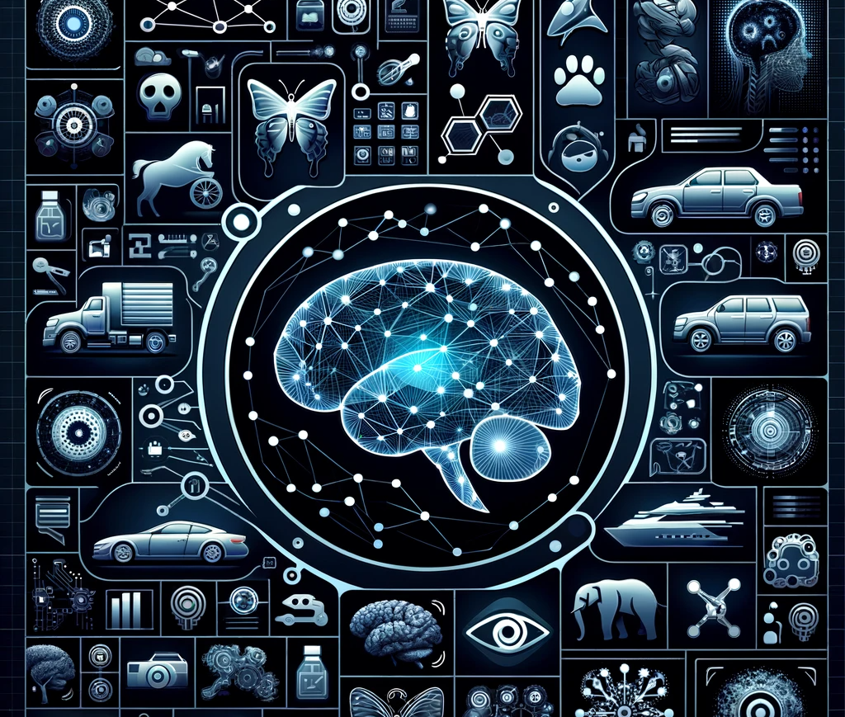
Generative AI Assignment 4: Generative Adversarial Network on CIFAR-10 dataset using Keras & Tensorflow
Devesh Surve
7th Feb 2024
ID: 002766974

Slide 2
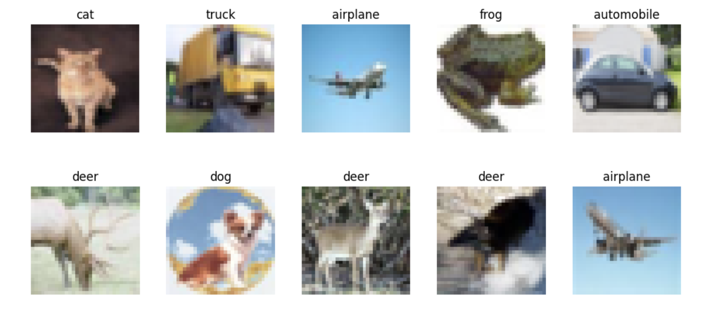
Problem Statement
CIFAR-10 Dataset Overview:
60,000 32x32 color images.
10 classes, with 6,000 images per class.
Diverse categories ( Animals & Vehicles )
Objective
Implement GANs with convolutional layers
Generate images for one class from CIFAR-10
Explore the effect of the noise vector on image generation
Challenges in Building GANs
Balancing the training of generator and discriminator
Avoiding model collapse
Ensuring diversity and quality of generated images

Slide 3

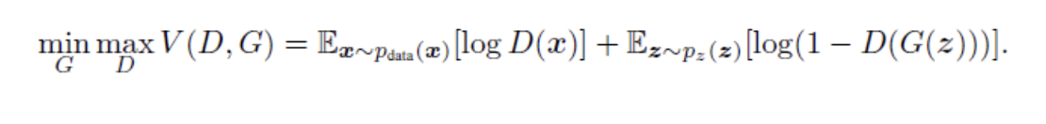
Training a GAN
Two main components: Generator (G) and Discriminator (D)
Adversarial training process: G generates, D evaluates
Minimax game: G minimizes, D maximizes loss
Goal: Reach Nash Equilibrium for optimal performance

Slide 4
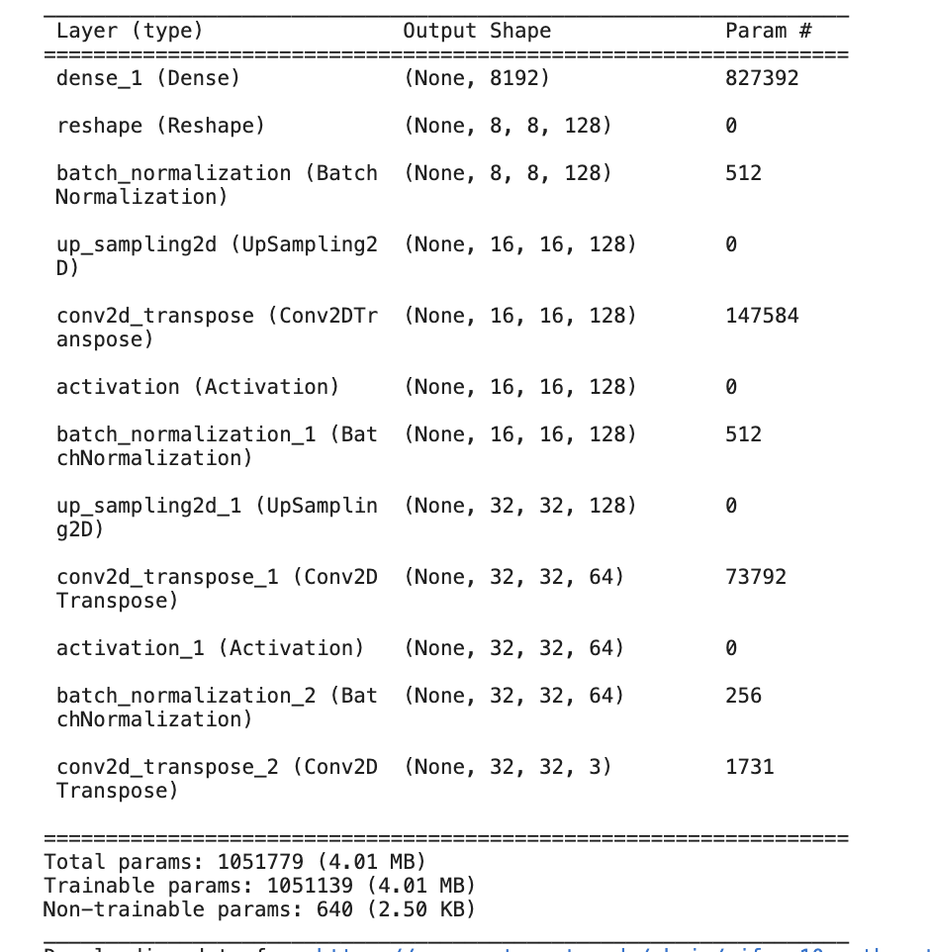
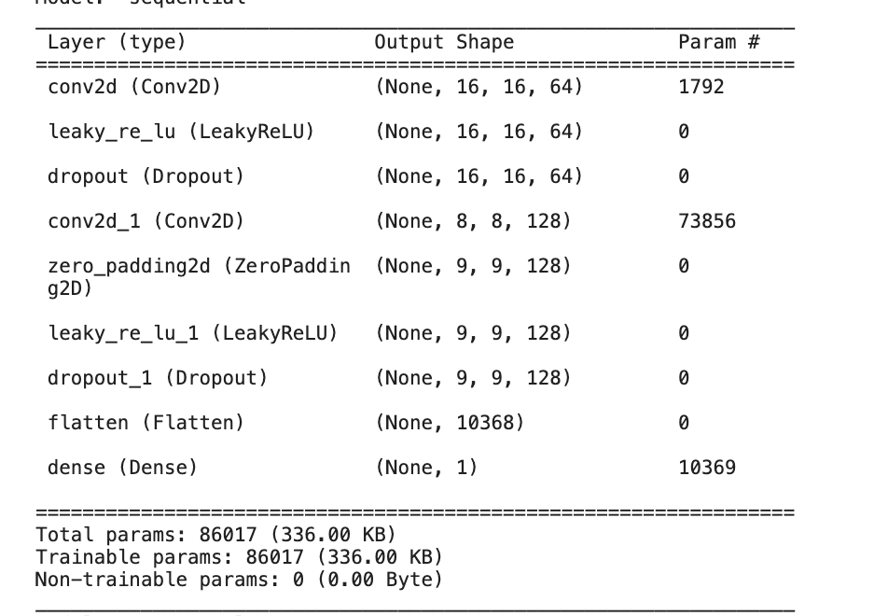
Modifications to Generator & Discriminator
Generator: Conv2D Transpose layers for upsampling
Discriminator: Convolutional Layers for feature extraction
Strided convolutions reduce dimensionality, focusing on salient features
Dropout layers prevent overfitting by adding randomness
ZeroPadding maintains feature dimensions during convolution

Slide 5
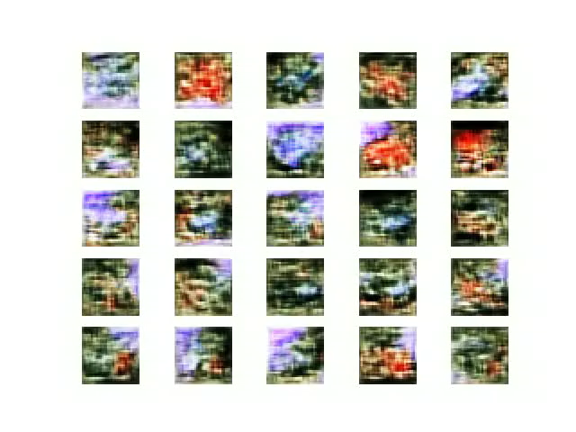
Model Output for different iterators

Slide 6
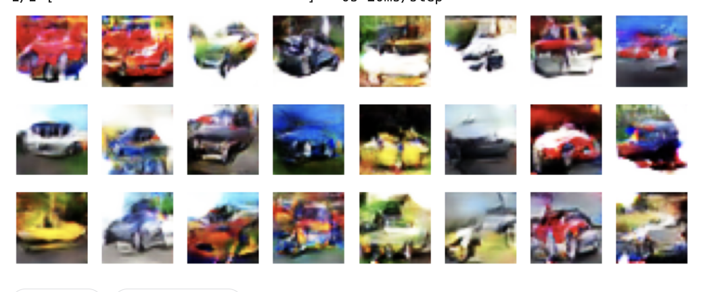
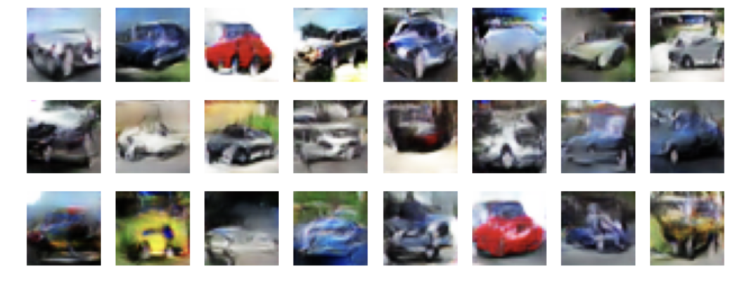
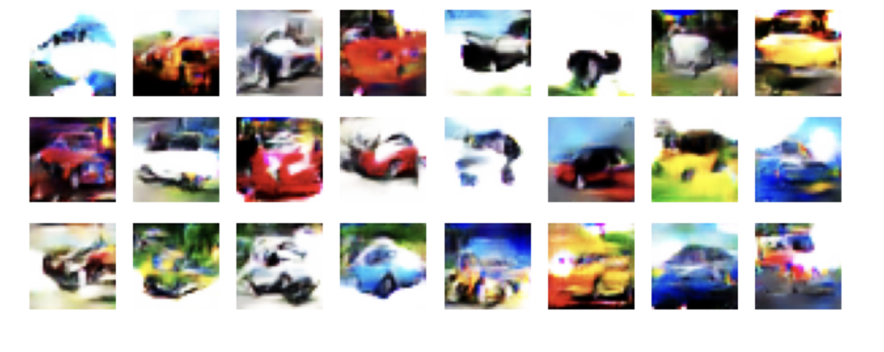
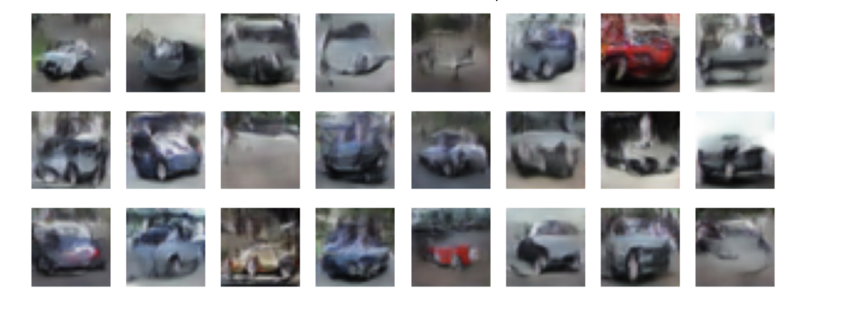
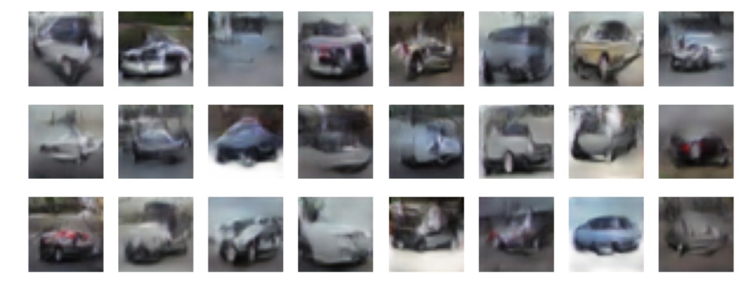
Effect of Controlling Noise Vector & Observations
Laplace
Normal Distribution:
Generates balanced and naturally varied images.
Ideal for general-purpose image generation.
Uniform Distribution:
Equal probability across all values.
Produces a wide variety of features, enhancing latent space exploration.
Truncated Normal Distribution:
Limits extremes, focusing on more consistent image features.
Useful for generating images with reduced outlier characteristics.
Logistic Distribution:
Heavier tails than normal, introducing pronounced feature variations.
Allows for testing model limits with more extreme variations.
Laplace Distribution:
Sharp peak and heavy tails, promoting central feature emphasis.
Balances typical and atypical features, useful for nuanced image generation.
Normal Distribution
Logistic
Uniform
Truncated Normal

